Slide 1
Single-cell sequencing
Ashis Saha
25 March 2019

Slide 2
Outline
What is single-cell sequencing?
Why do we study?
Single-cell DNA sequencing (with application)
Single-cell RNA Sequencing (scRNA-seq)
Characteristics of data
Applications
Multiple types of sequencing from a single-cell

Slide 3
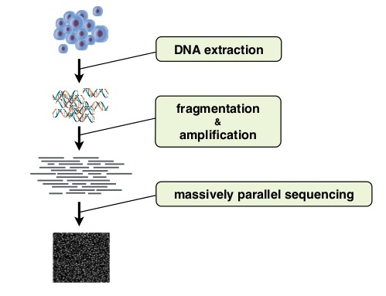

Bulk (traditional) vs. Single-cell sequencing
~6-7 pg genomic DNA in a cell ^{1.}
>= 1 ng DNA required for bulk seq.
Bulk Sequencing
Single-Cell Sequencing
1. https://www.nature.com/articles/s41598-018-23325-2
Notes:
Amount of DNA/RNA
Average signal vs. single-cell level signal

Slide 4
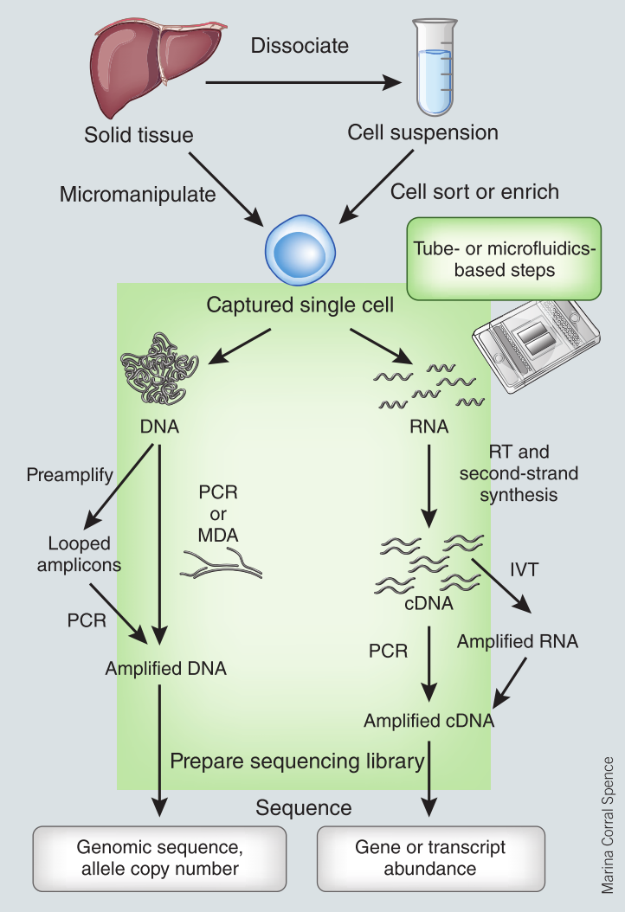
Methods
Nawy T. 2013. Single-cell sequencing. Nat Methods 11: 18–18.

Slide 5
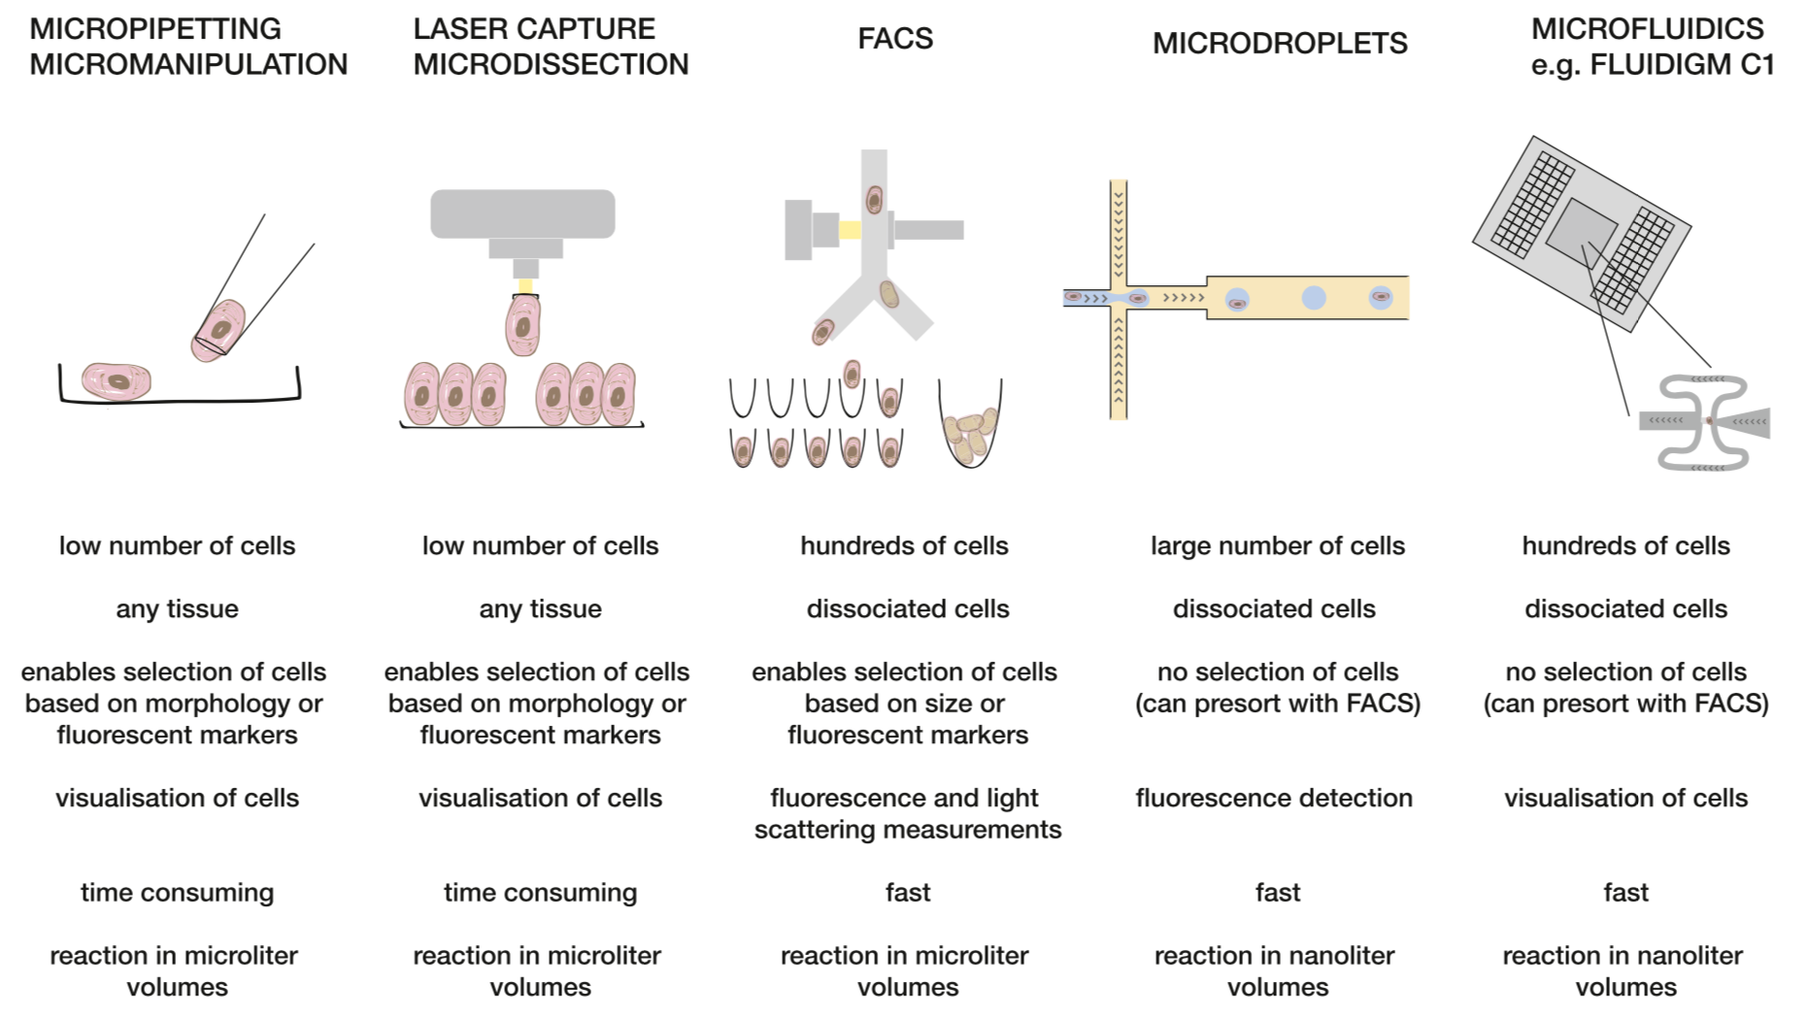
Capturing single-cells
Kolodziejczyk et al. 2015. The technology and biology of single-cell RNA sequencing. Molecular cell.

Slide 6
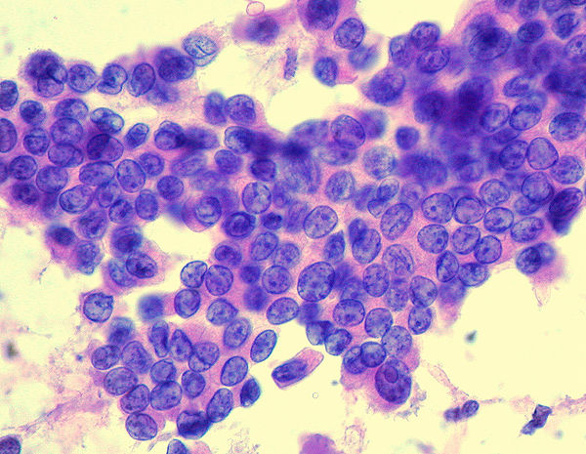
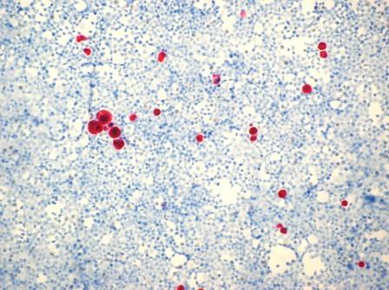

Why should we care for “single-cell” data?
Study diseases cells directly
Study rare cells
Study micro-organism
Papillary Thyroid Cancer Cells¹
Bone marrow cells from a breast-cancer patient²
Fungi³
1. Wikipedia 2. http://www.pathogenesys.com 3. https://edu.glogster.com

Slide 7
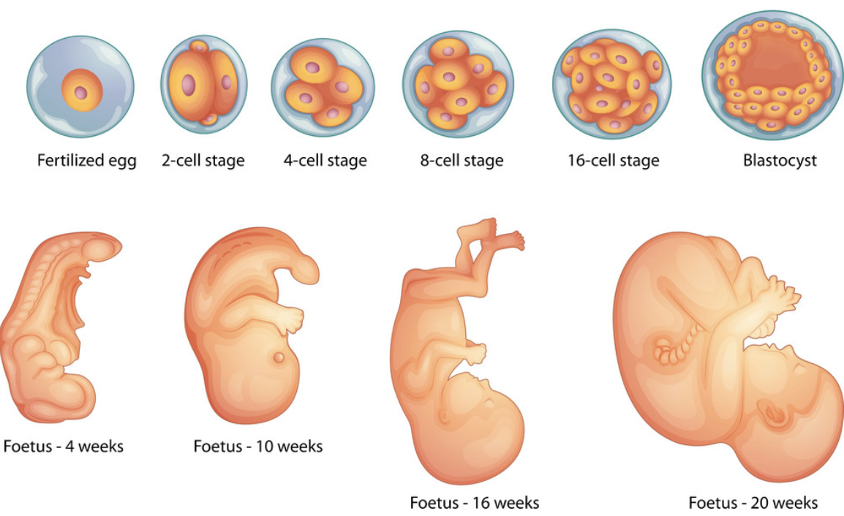
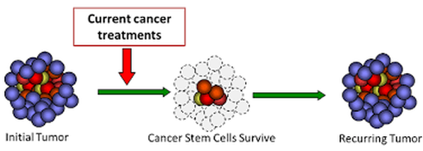
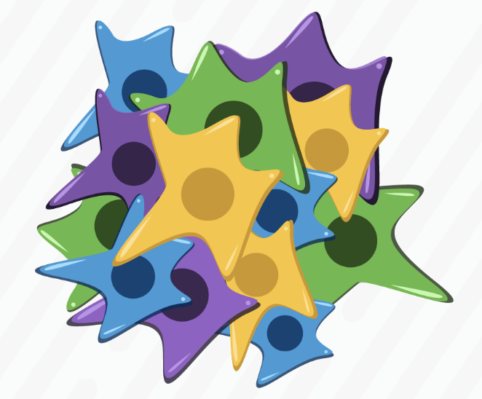
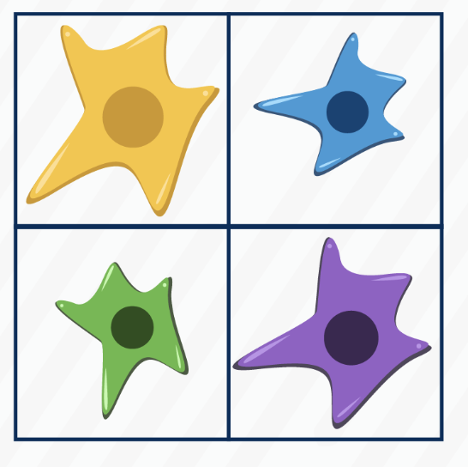
Why should we care for “single-cell” data?
Embryonic Development
Study cells unresponsive to drugs²
Cell-specific biology
Human Embryonic Development¹
1. www.vectorstock.com 2. http://www.breastcancerstudyandsupport.org 3. https://community.10xgenomics.com/

Slide 8
Effect of incomplete DNA capture on sequencing
If some parts of chromosomes are not captured, sequence of those parts cannot be determined. Consequently, lots of gaps remain in the whole genome sequencing from single-cells.
In a 2011 study, only ~6% genome could be sequenced.
Still cool analysis is possible.
Navin N et al. 2011. Tumour evolution inferred by single-cell sequencing. Nature 472: 90–94.

Slide 9
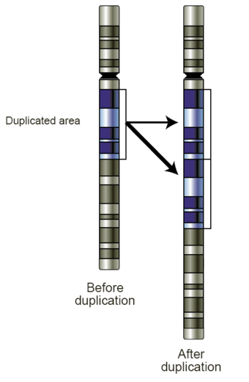
Tumor evolution : Copy Number Variation (CNV)
Studied CNV in breast cancer evolution.
CNV: variation of the number of copies of a particular gene from one individual to other. It is a result of duplication or deletion event.
Diploid: 2 sets of chromosomes.
Aneuploid: Unusual #chromosomes.
Nicholas Navin
Navin N et al. 2011. Tumour evolution inferred by single-cell sequencing. Nature 472: 90–94.

Slide 10
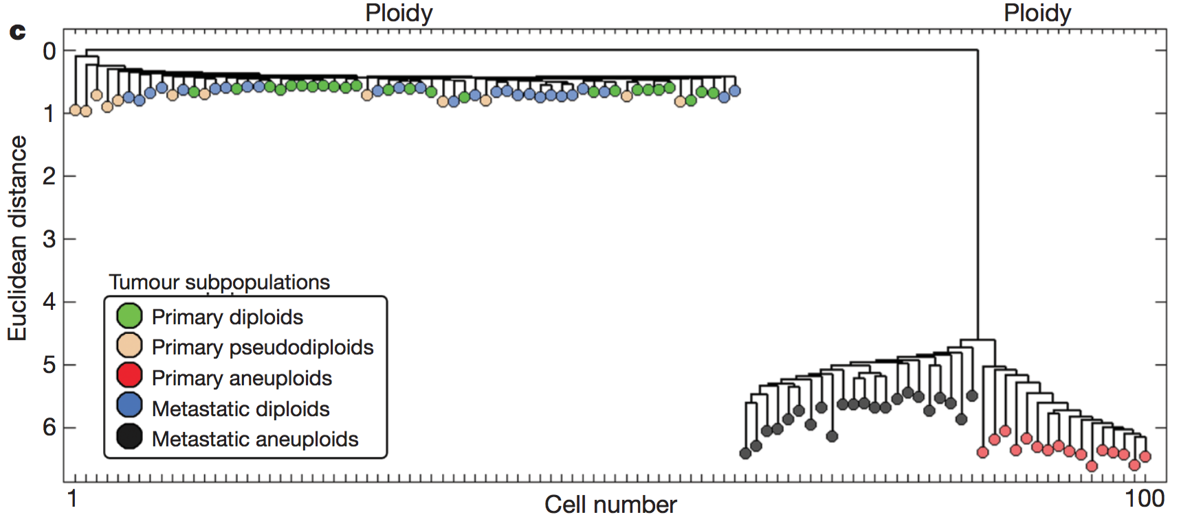
Tumor evolution : How does breast cancer metastasize?
Sequenced 52 cells from breast (primary) and 48 cells from liver (metastatic).
Computed CNV profiles.
Hierarchical clustering of CNV.
Aneuploids are very different from diploids.
Metastatic aneuploids did not mix-up with primary aneuploids.
One primary cell gained aneuploidy, and multiplied. One of them metastasized to liver and then multiplied there.

Slide 11
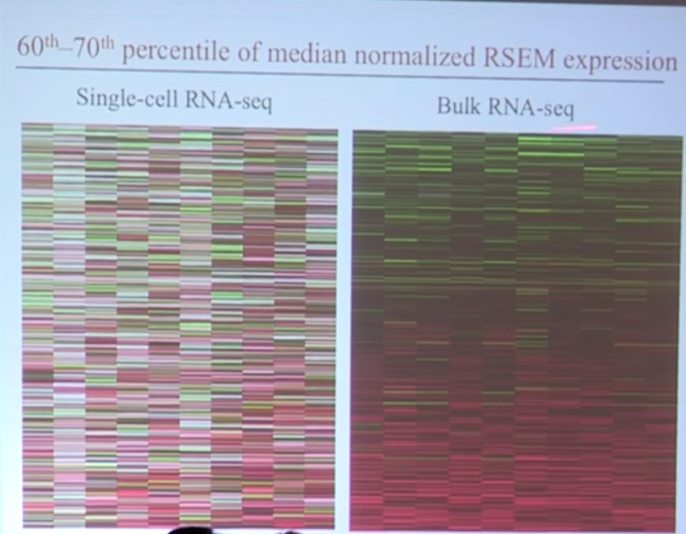
Effect of incomplete RNA capture on sequencing
If RNA from a gene is not captured (dropout), it appears as not-expressed (0).
In fact, single-cell RNA-sequencing produces sparse non-zero matrices.
 | Gene-1 | Gene-2 | Gene-3 | Gene-4 | Gene-5
Cell-1 |  | 1 |  |  | 7
Cell-2 |  |  | 4
Cell-3 | 3
Cell-4 |  | 5
Cell-5 |  |  | 2 |  | 2
Cell-6 | 7 |  | 3
Bacher R, Kendziorski C. 2016. Design and computational analysis of single-cell RNA-sequencing experiments. Genome Biol 17: 63.

Slide 12
Dropout/Zero-Inflation?
Current approaches consider extra amount of zeros as technical error (Zero Inflation or Dropout)
Impute data
MAGIC (nearest neighbor based imputation)
SAVER
DeepImpute
According to recent papers, “there is no zero-inflation in droplet based single-cell data. Zeros are due to biological variability.”
Svensson, V. (2019). Droplet scRNA-seq is not zero-inflated. BioRxiv, Townes, F. W., Hicks, S. C., Aryee, M. J., & Irizarry, R. A. (2019). Feature Selection and Dimension Reduction for Single Cell RNA-Seq based on a Multinomial Model. BioRxiv, 574574.

Slide 13
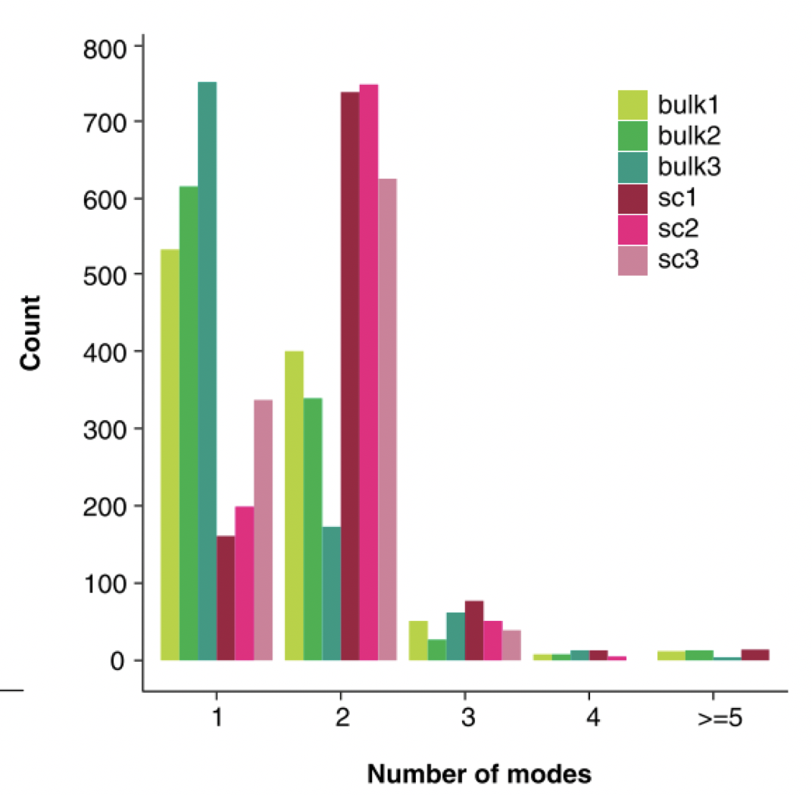
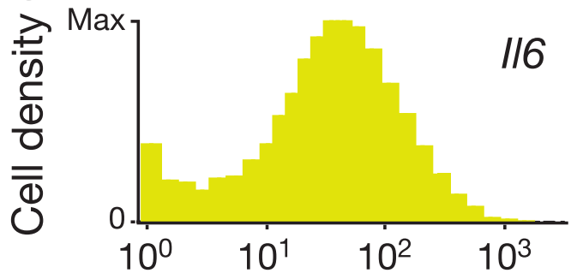
Modality of expression
Read count
Shalek et al., Nature Letter (2013)
Bacher et al., Genome Biology (2017)

Slide 14
Keep in mind
Sparse data
Assumption of normality distribution of expression is invalid.
Multimodality of expression
Assumption of normality distribution of expression is invalid.
Difference may occur in modality of expression.
Multiple sample from same individuals
Assumption of IID is invalid.
Simple differential expression for RNA-seq require special methods: MAST (dropout+multimodality), SCDE (ZINB), SCDD (multimodality).

Slide 15
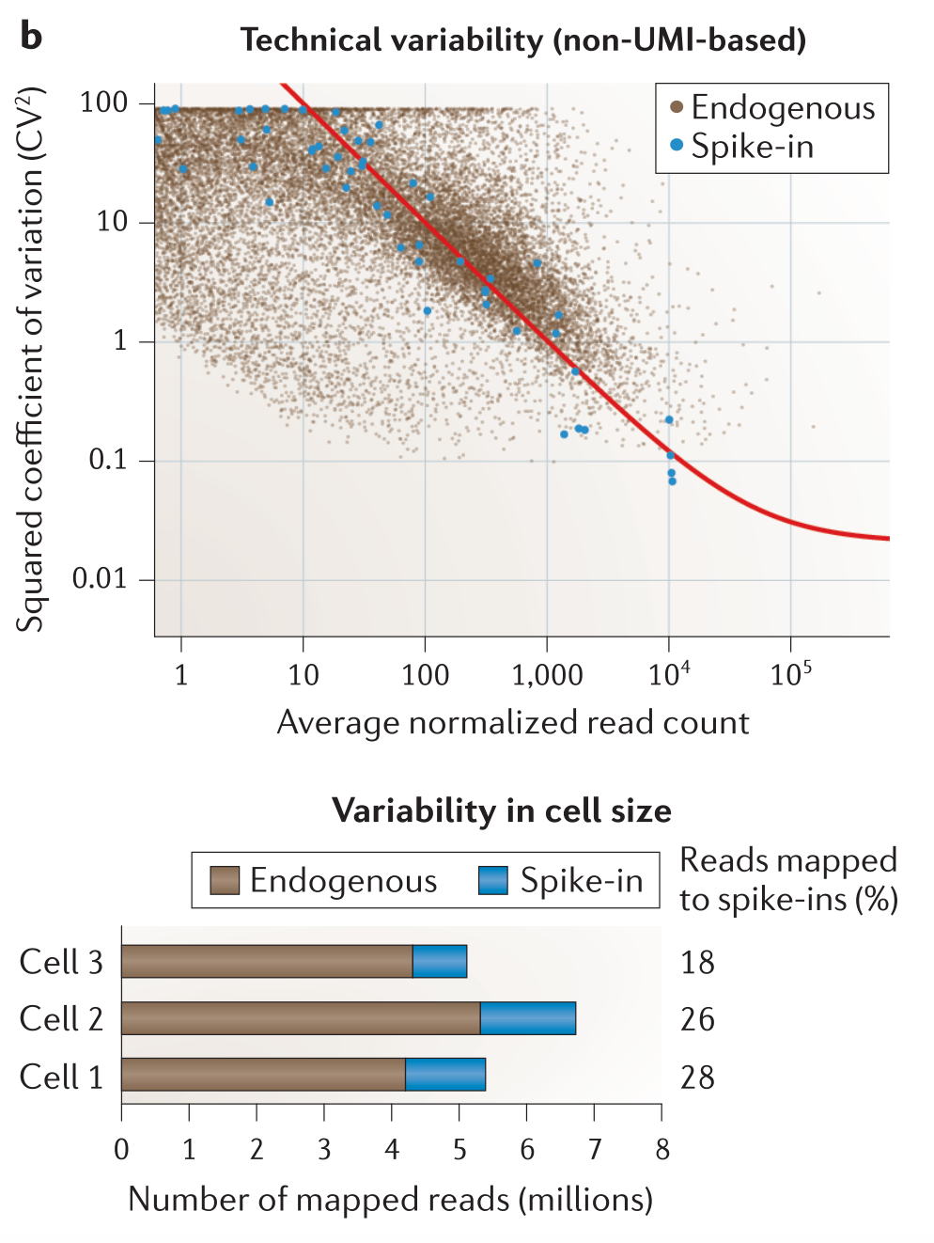
Spike-in
scRNA-seq expression depends on starting material. RPKM/FPKM/TPM etc. do NOT count for starting RNA content.
So, we add synthetic transcripts of known sequence in known quantity. They are called RNA spike-ins.
If same amount of spike-ins used for each cell, we can estimate technical noise.
From relative amount of endogenous RNA and spike-in, we estimate RNA content.
Example: External RNA Control Consortium (ERCC) set of 92 synthetic spikes
Stegle O, Teichmann SA, Marioni JC. 2015. Computational and analytical challenges in single-cell transcriptomics. Nat Rev Genet 16: 133–145.

Slide 16
Unique Molecule Identifier (UMI)
If one gene is amplified 20% more in one round, then it will be 1.2^10= 6.2 times more abundant after 10 rounds of PCR.
Solution: Use UMIs, random sequences attached to individual molecules prior to PCR.
Each molecule is now unique and we can count them.
These days – each cell is also barcoded for parallel sequencing.

Slide 17
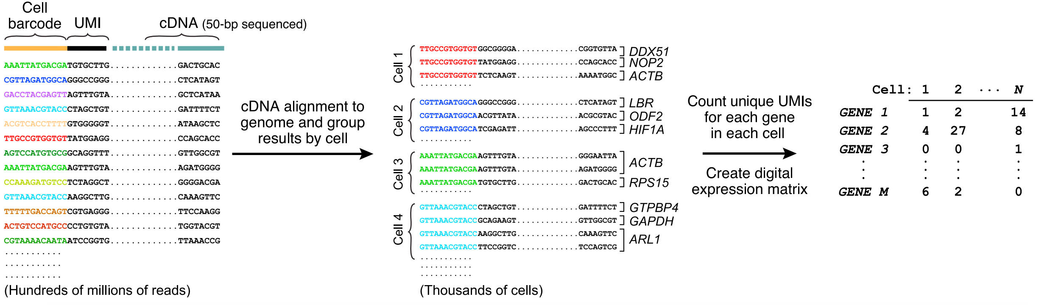
Barcode+UMI to count matrix
* Barcode=Cell, UMI=RNA
Evan Macosko et al. Highly Parallel Genome-wide Expression Profiling of Individual Cells Using Nanoliter Droplets, Cell 2015.

Slide 18
What if 2 cells are captured?
It’s called a doublet.
DoubletFinder: https://www.biorxiv.org/content/10.1101/352484v3

Slide 19
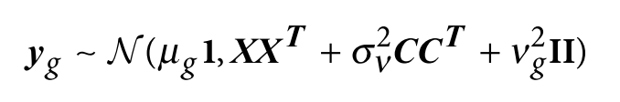
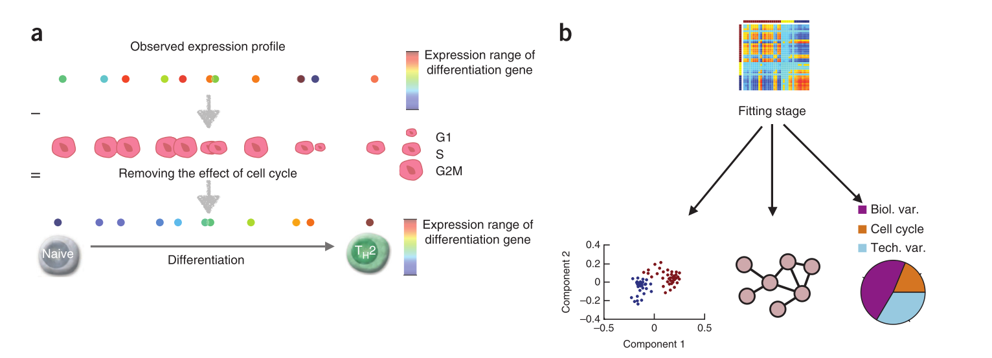
Technical/hidden factors
Hidden factors
Observed Covariates
Buettner F et al. 2015. Computational analysis of cell-to-cell heterogeneity in single-cell RNA-sequencing data reveals hidden subpopulations of cells. Nat Biotechnol 33: 155–160.

Slide 20
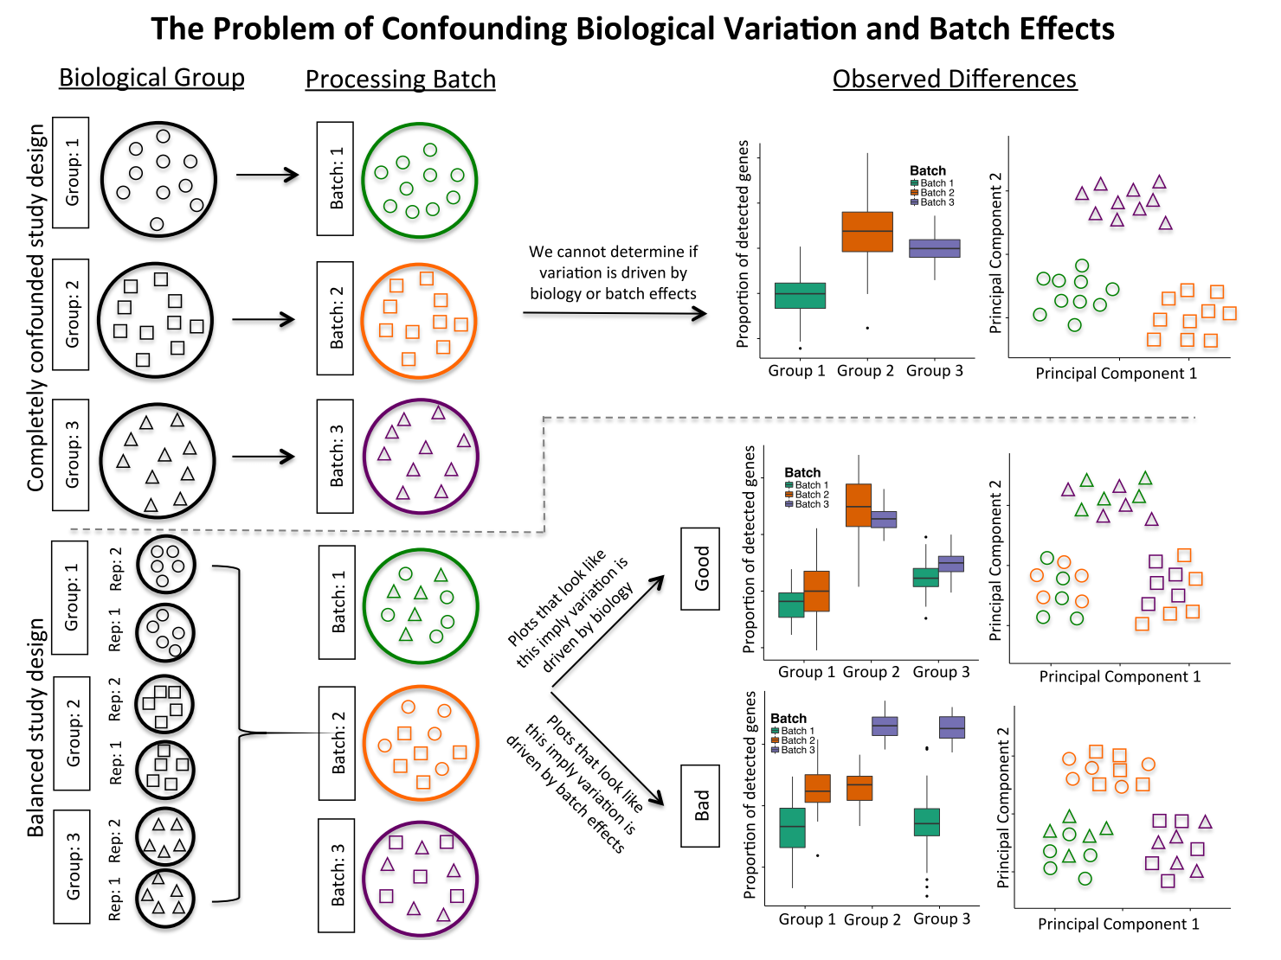
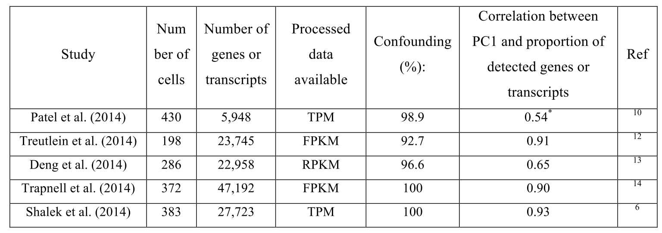
Confounded study
Hicks SC, Teng M, Irizarry RA. 2015. On the widespread and critical impact of systematic bias and batch effects in single-cell RNA-Seq data. bioRxiv.

Slide 21
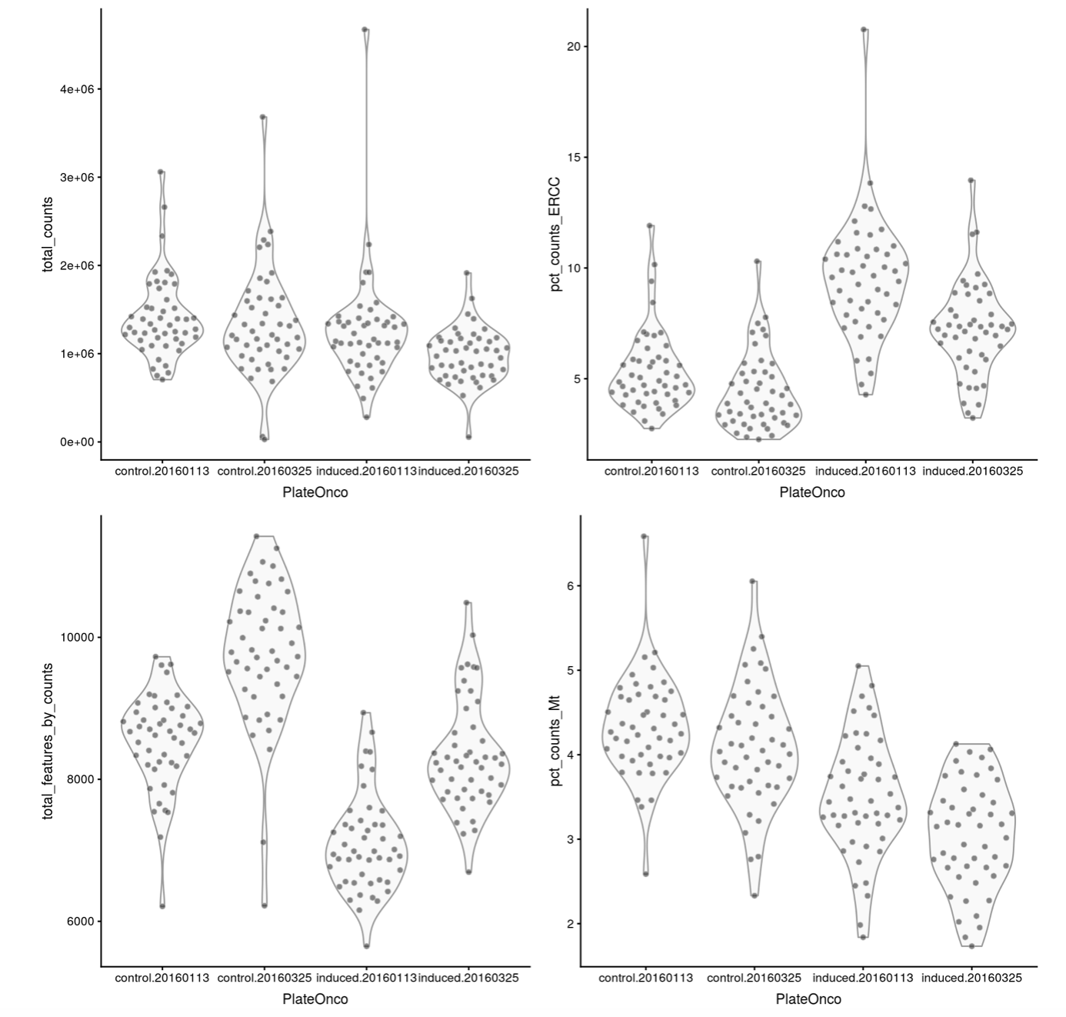
QC
library size
Percentage of
Spike-ins
number of expressed genes
Percentage of mitochondrial reads

Slide 22
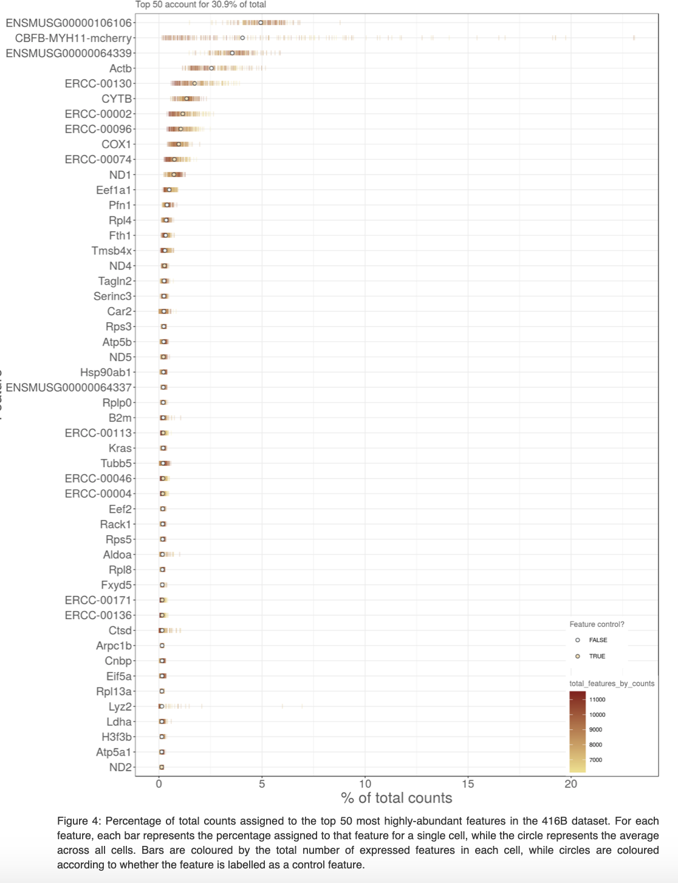
QC
House-keeping genes, Ribosomal and mitochondrial genes should most highly expressed.
Dominance of ERCC is not good.

Slide 23
Cell types
Cell discovered in 1865.
But still cell-type is not well defined.
Which criteria to define cell type?
Existence of nucleus (prokaryotic/eukaryotic)?: Too broad types.
Location / Organ where the cell was found? : multiple cell-types in an organs.
Cell functions? Same cell takes part in different functions
Computational methods with single-cell omics data can define cell types.
Human Cell Atlas : Catalog all cell-types in human. http://humancellatlas.org/

Slide 24
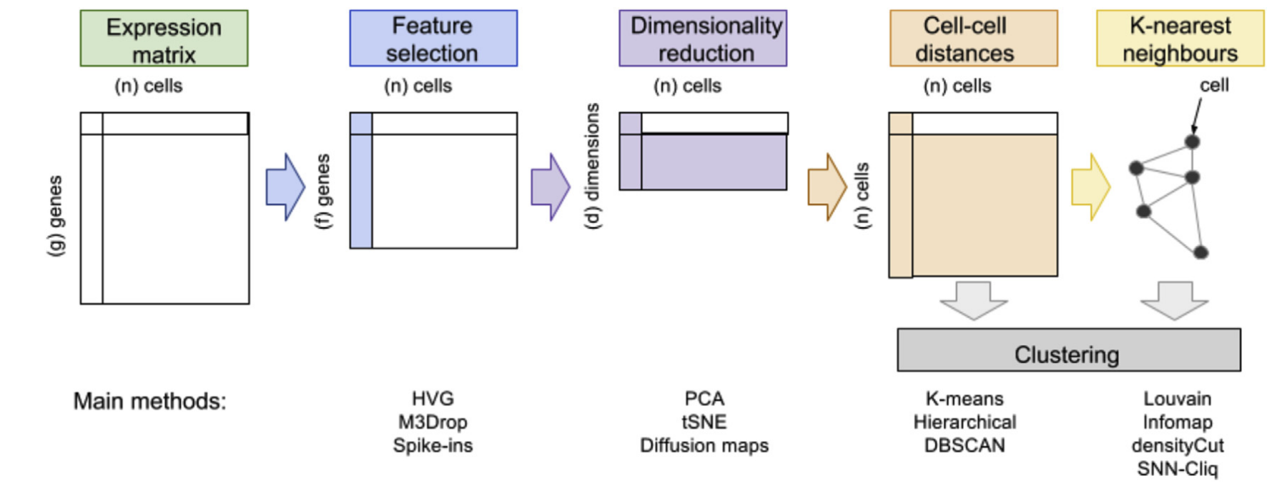
Finding cell-types (Clustering)
UMAP

Slide 25
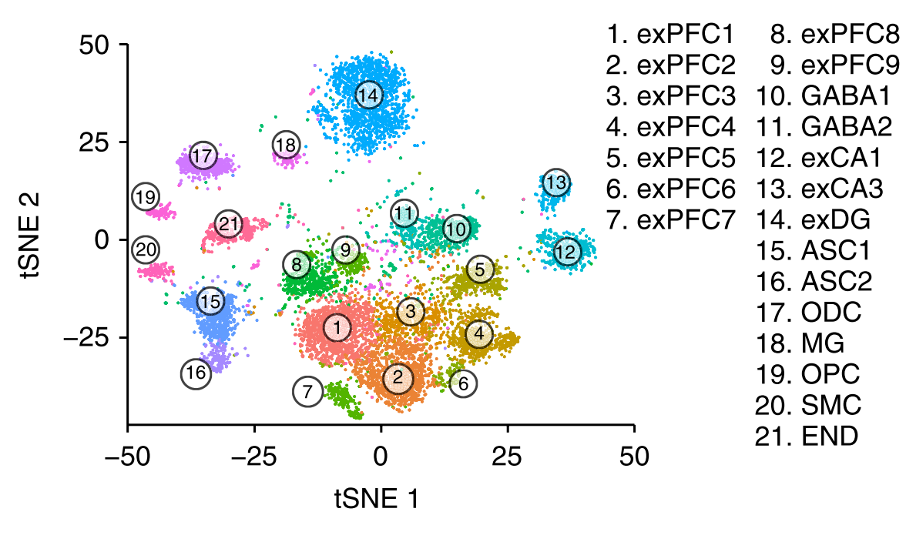
Example: Cell types ﻿in adult frozen mouse hippocampus and prefrontal cortex.
PCA -> Distance -> k-NN -> Infomap
tSNE is only for visualization, not for analysis (use UMAP instead)
Habib et al., Massively parallel single-nucleus RNA-seq with DroNc-seq, Nat Meth (2017)

Slide 26
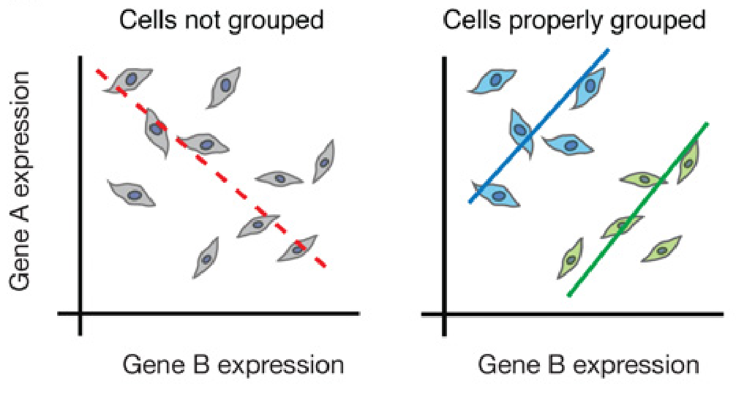
Advantage of scRNA-seq: Simpson Paradox
Trapnell C. 2015. Defining cell types and states with single-cell genomics. Genome Res 25: 1491–1498.

Slide 27
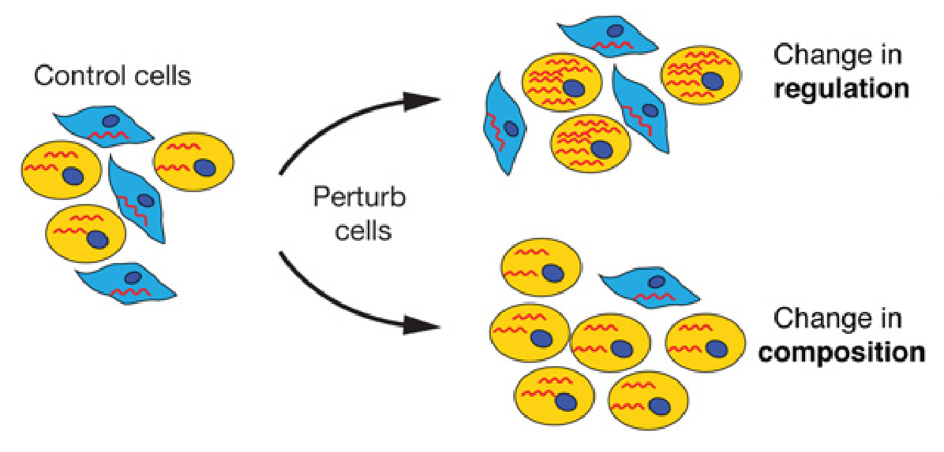
Advantage of scRNA-seq: Change in regulation or composition?
Trapnell C. 2015. Defining cell types and states with single-cell genomics. Genome Res 25: 1491–1498.

Slide 28
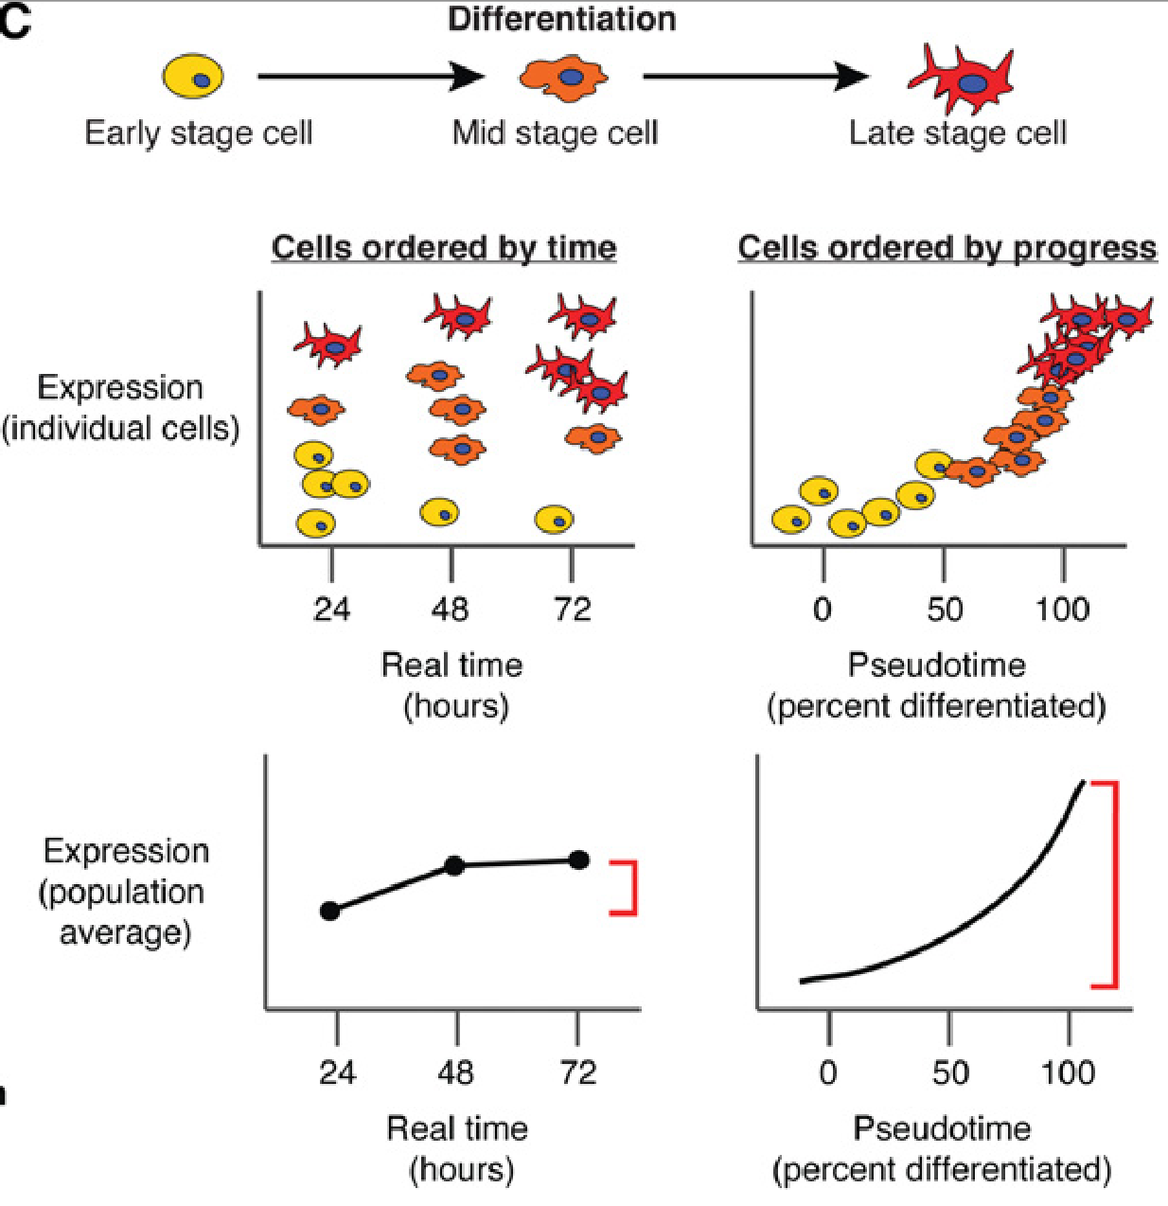
Advantage of scRNA-seq: Strong signal in time-series data
Trapnell C. 2015. Defining cell types and states with single-cell genomics. Genome Res 25: 1491–1498.

Slide 29
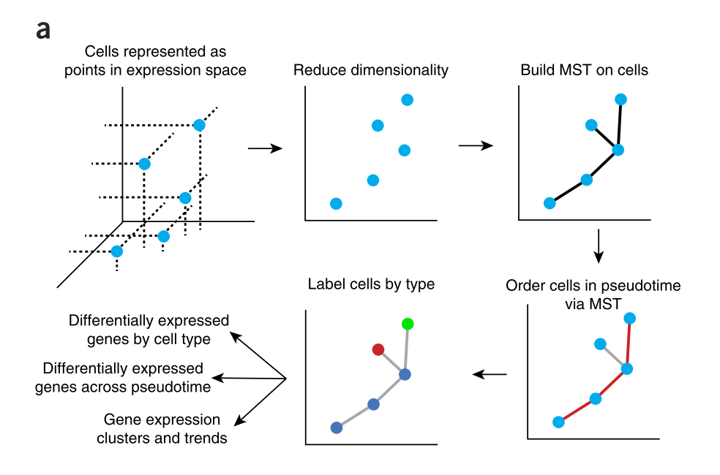
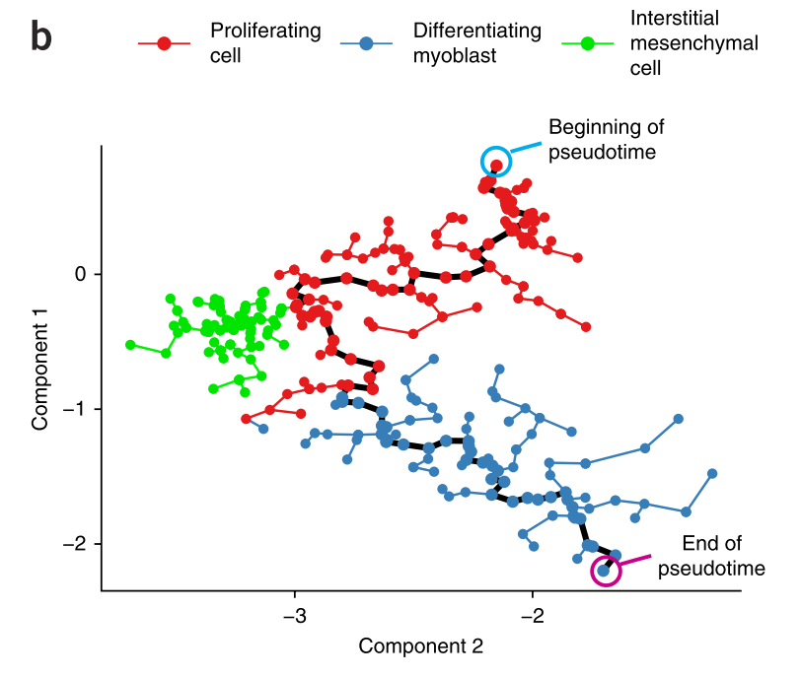
But cells do not come with differentiation tag. We have to learn pseudo-temporal orderi ng.
Cole Trapnell et al., Monocole, Nat Biotech 2014

Slide 30
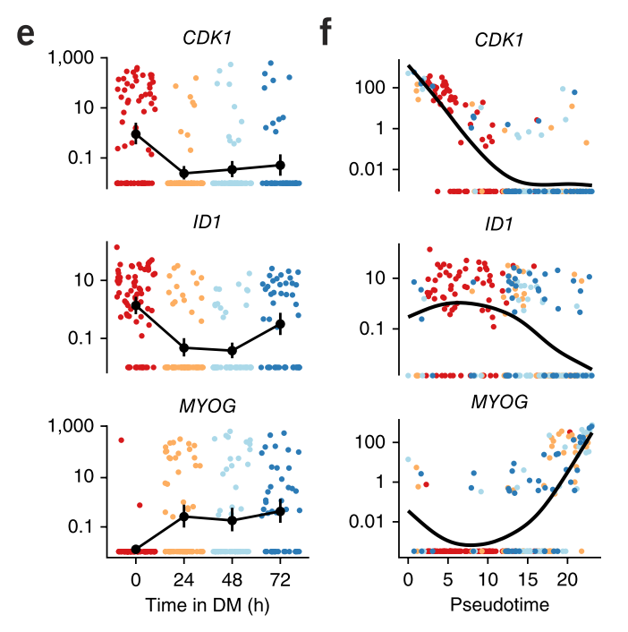
Human myoblasts differentiation

Slide 31
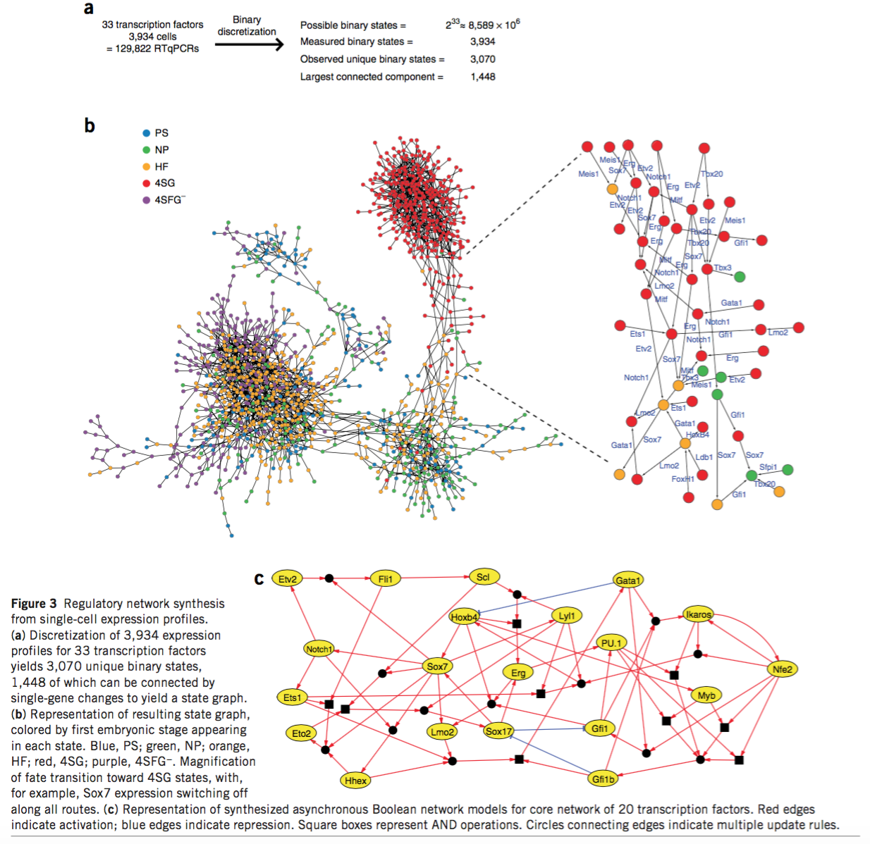
Network inference
Moignard V et al. 2015. Decoding the regulatory network of early blood development from single-cell gene expression measurements. Nat Biotechnol 33: 269–276.

Slide 32
Multiple types of sequences from a single cell
Genetic + Epigenetic + Transcriptome (scTrio-seq)
Transcriptome + Protein (REAP-seq)
Live cell imaging + RNA-seq (SCOPE-seq)

Slide 33
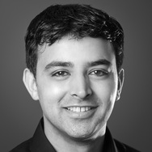
Software development
Generally single-cell data is big, require special tools.
Seurat: https://satijalab.org/seurat/
Rahul Satija

Slide 34
Summary: Lots of things are happening ... Thanks!

